Slide 1
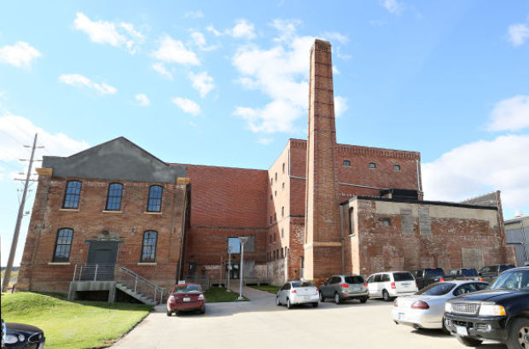
More than 300 historic buildings have been rehabilitated using the credit since 2001
The tax credit has attracted over $900 Million in private sector and federal investment, $800 Million in rehabilitation and an additional $90 Million in related new construction
Conservatively, the additional local property tax generated by these projects amounted to more than $12,000,000 in 2013 alone.
$45 Million annually identified by the Legislature for HPCED Tax Credits. After two “catch-up” years the program has now received its full allocation for SFY 2017
Large and Small Categories

Slide 2
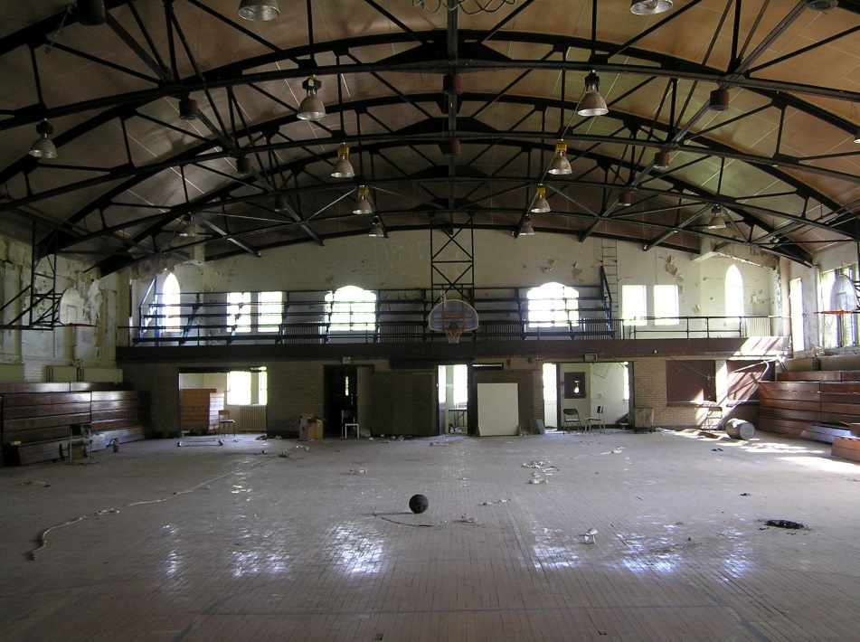
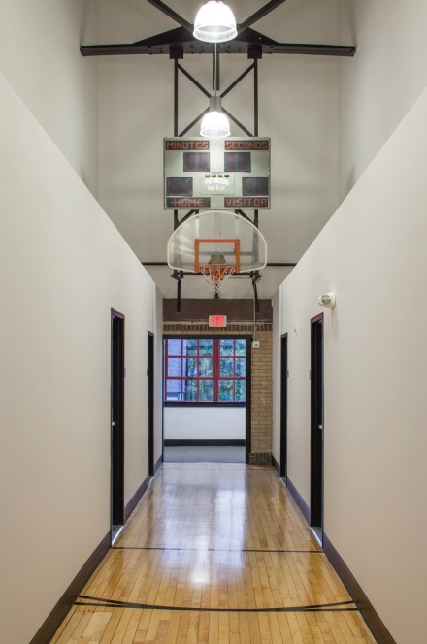
Preservation Using Federal Tax Credits in FFY 2014
Kansas
  Approved Part 1-13
  Approved Part 2-11
  Approved Part 3- 9
  Total QRE’s at Completion $32,340,132.00
Missouri
  Approved Part 1-89
  Approved Part 2-109
  Approved Part 3-60
  Total QRE’s at Completion $155,051,092.00
Minnesota
  Approved Part 1-11
  Approved Part 2-10
  Approved Part 3- 8
  Total QRE’s at Completion $119,677,966.00
Nebraska
  Approved Part 1-12
  Approved Part 2- 7
  Approved Part 3- 8
  Total QRE’s at Completion $44,003,882.00
Iowa
  Approved Part 1-43
  Approved Part 2-39
  Approved Part 3-16
  Total QRE’s at Completion $75,993,542.00

Slide 3
In 2006, Des Moines had over 1 million sq. ft. of vacant Class B & C commercial space. This vacant space was decreasing rents and property assessments.
2005/06 and 2013/14 Assessments for
Residential Conversions in Downtown
Des Moines
Notes:
Eleven completed projects:
Repurposed 699,200 sq. ft. Class B & C office space and vacant warehouse. About 18,000 sq. ft. demolished
769 new housing units
Assessed building valuations went from $4.7 million to $62.1 million*
Three additional projects in progress:
Over 400,000 sq. ft.
300 new housing units
Wilkins (Younkers), R & T Lofts, Randolph Hotel complex
*For mixed use projects, only housing portion of assessment used.

Slide 4
How Much!?
Federal Program
20%
Of Qualified Rehabilitation Expenditures
State Program
25%
Of Qualified Rehabilitation Expenditures
= 45%
Of the same Expenses from the 2 Levels of Government

Slide 5
What’RE QRE’s?
Hard Costs of Construction associated with “Real Property”
Not Volume Increases (Additions)
Not Parking or Landscape Improvements
Not Furniture and Equipment
Soft Costs that can be properly Capitalized as Costs of Construction
Not Program or Application Fees
Not Federal Syndication Costs (legal)
Not Permanent Financing Fees

Slide 6
HISTORIC PRESERVATION AND CULTURAL AND
ENTERTAINMENT DISTRICT TAX CREDITS
FOR PROJECTS REGISTERED ON OR AFTER AUGUST 15, 2016
261—49.1(303,404A) Purpose. A historic preservation and cultural and entertainment district tax credit (hereinafter referred to as “historic tax credit”) may be applied against the income tax imposed under Iowa Code chapter 422, division II, III, or V, or Iowa Code chapter 432 for qualified rehabilitation projects that have entered into and complied with an agreement with the department of cultural affairs economic development authority (hereinafter referred to as “the departmentauthority”) and complied with all applicable terms, laws, and rules. The program is administered by the departmentauthority with the assistance of the department of revenuecultural affairs. The general assembly has mandated that the authority, department of cultural affairs and the department of revenue adopt rules to jointly administer Iowa Code chapter 404A. In general, the department of cultural affairs evaluates whether projects comply with the prescribed historic standards for rehabilitation. Once the historic components have been approved, the authority enters into an agreement with the project owner and issues a tax credit upon completion of all program requirements and verification of qualified rehabilitation expenditures.

Slide 7
10. Get your Part 1 in NOW!
Part 1 – Evaluates the building’s integrity and significance and project eligibility.
Part 1.5 Pre-Application Meeting – Offers feedback that will enable you to prepare better
applications for the Part 2 submittal.
Part 2 – Evaluates that the proposed rehabilitation work meets
The Secretary of the Interior’s Standards for Rehabilitation.
Part 2B – Evaluates submitted materials for the project’s planning and financial readiness.
Agreement – Establishes the terms and conditions that must be met to receive the
tax credit and establishes the estimated amount of the tax credit.
Part 3 - Evaluates that the completed work has met The Secretary of the Interior’s Standards for Rehabilitation and that all other requirements of the agreement, laws, and regulations have been met.

Slide 8
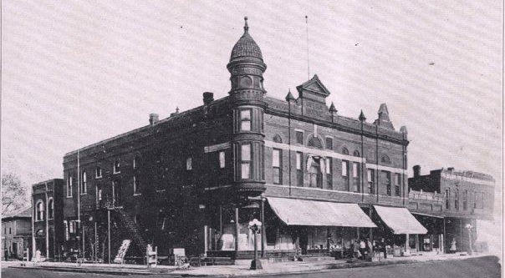
“Your” 50 Year-Old Building
Federal Program
Listed on the National Register of Historic Places (NRHP)
…or will be listed within an specified time from the placed-in-service date.
Substantial Rehabilitation
Income-producing property
Eligible Tax payer/ Fee Simple Owner,
OR will be with signed letter of permission
from current fee–simple owner
State Program
Eligible for or listed on the NRHP
Designated as a Local Landmark
Barns built before 1937
Private residences
Substantial Rehabilitation
Eligible Tax payer/ Fee Simple Owner,
OR will be as evidenced by successful Federal
Application

Slide 9
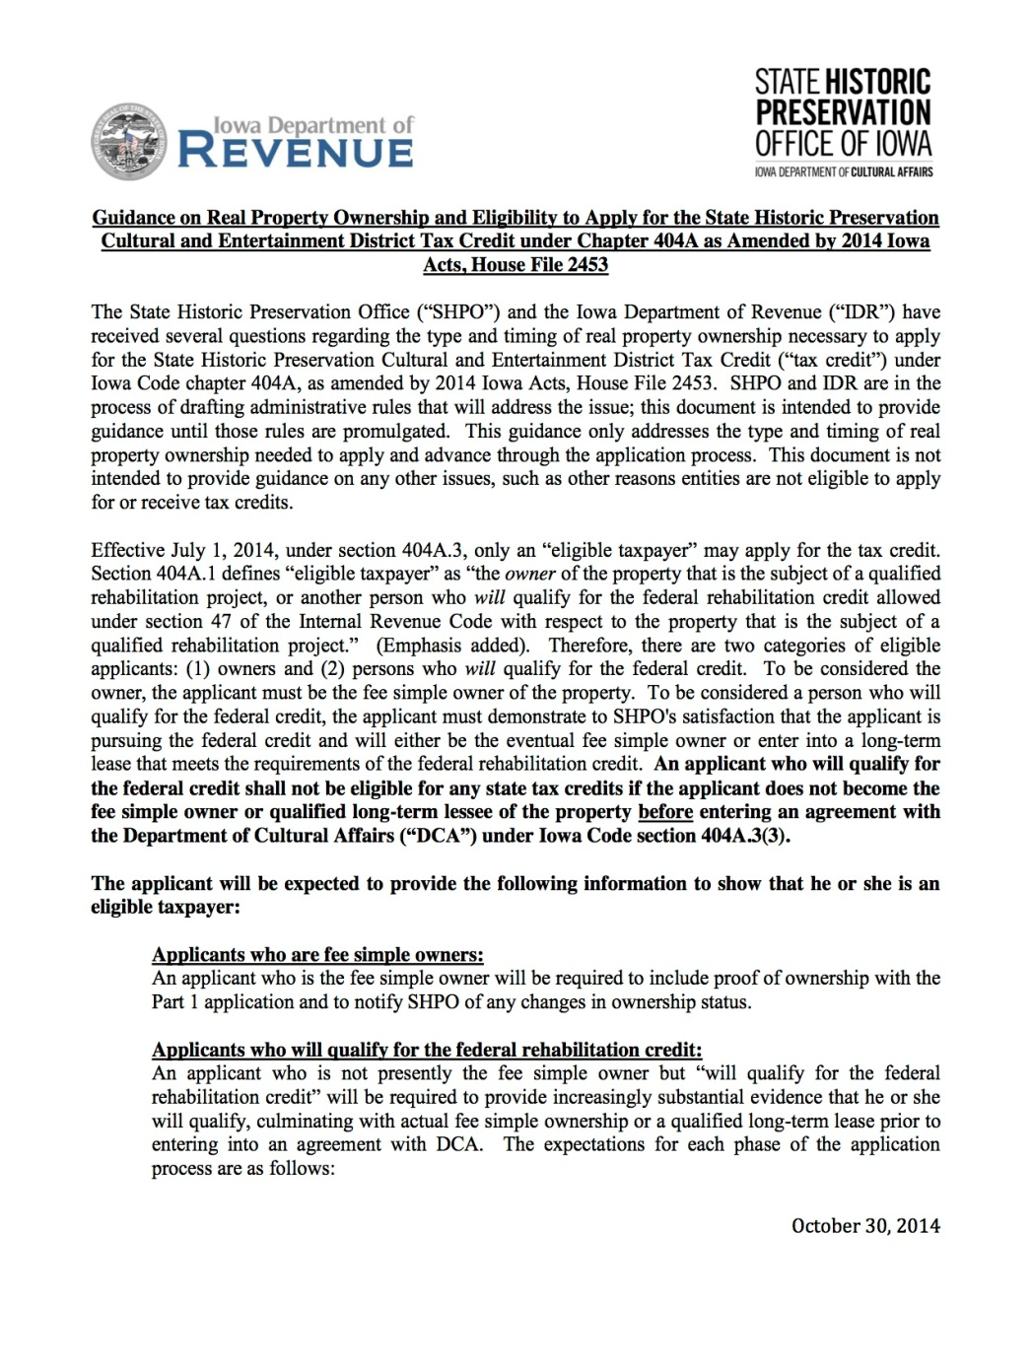
Who May Apply:
Fee Simple Owners!
So…What’s a non-owner developer to do?
Enter into a development agreement with the current owner (provided the current owner is not a tax-exempt entity)
Qualify through the Federal Certified Historic Structure Program (HTC)

Slide 10
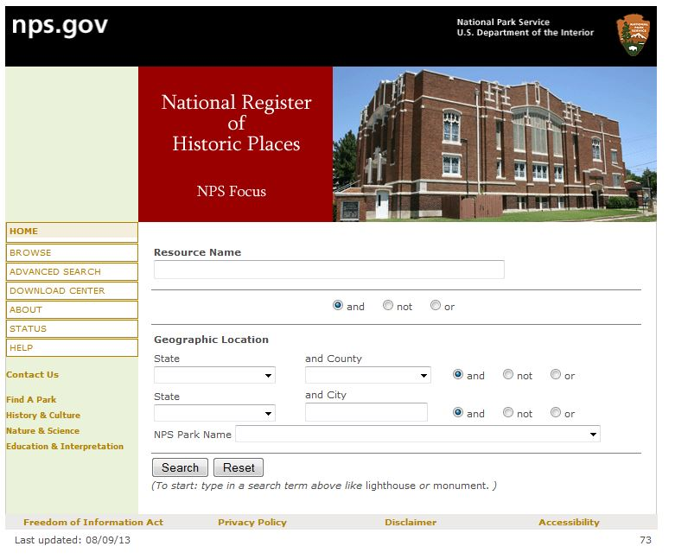
Identification and Evaluation of Historic Properties
  What is a Historic Property?
    Resources that are listed on or eligible for listing on the National Register of Historic Places (NRHP) including:
    Buildings, Districts, Structures, Objects, Sites (including archaeological sites)
    How do we identify historic properties?
    Check the National Register of Historic Places Database: http://nrhp.focus.nps.gov/natreghome.do?searchtype+natreghome
    Check the State of Iowa Inventory by contacting the inventory coordinator Berry Bennett at 515.281.8742 or berry.bennett@iowa.gov

Slide 11
Establishing Significance
PART ONE
Period of Significance
  If a property is NRHP eligible you document the era (date range) for when it achieved significance.
  Typically for properties eligible for architecture/workmanship the Period of Significance is the date of construction (Criterion A)
  Typically for properties eligible for association with a significant person the Period of Significance is the date the significant person used the property. (Criterion B)
  Typically for properties eligible for association with a significant event the Period of Significance is the time of the event. This can be a single event like a speech, rally, convention, tragic event, accident, etc. usually 1-3 days, or it can be a longer period such as the development and growth of a commercial corridor maybe 20-50 years. (Criterion C)

Slide 12
PART ONE
Establishing Significance
Integrity
  Does the building retain sufficient integrity to be eligible for the National Register?
  Seven Aspects of Integrity:
    Location
    Design
    Setting
    Materials
    Workmanship
    Feeling
    Association
  Basically – would someone from the period of significance recognize the property today?

Slide 13
PART ONE POINT FIVE
Meet to Discuss with IEDA/SHPO
Thirty days after Part 1 is submitted
“That hour with Iowa SHPO staff is a far, far better thing…than I have ever done; it is a far, far better rest that I go to than I have ever known.”
-what we imagine applicants say after a 1.5

Slide 14
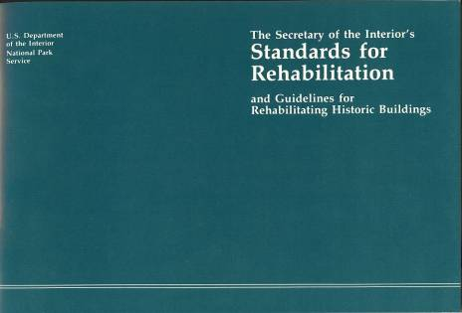
PART TWO

Slide 15
PART TWO
Rehabilitation Standards
Standard 1
A property shall be used for its historic purpose or be placed in a new use that requires minimal change to the defining characteristics of the building and its site and environment.
Standard 2
The historic character of a property shall be retained and preserved. The removal of historic materials or alteration of features and spaces that characterize a property shall be avoided.
Standard 3
Each property shall be recognized as a physical record of its time, place, and use. Changes that create a false sense of historical development, such as adding conjectural features or architectural elements from other buildings, shall not be undertaken.
Standard 4
Most properties change over time; those changes that have acquired historic significance in their own right shall be retained and preserved
Standard 5
Distinctive features, finishes, and construction techniques or examples of craftsmanship that characterize a historic property shall be preserved.

Slide 16
PART TWO
Rehabilitation Standards
Standard 6
Deteriorated historic features shall be repaired rather than replaced. Where the severity of deterioration requires replacement of a distinctive feature, the new feature shall match the old in design, color, texture, and other visual qualities and, where possible, materials. Replacement of missing features shall be substantiated by documentary, physical, or pictorial evidence.
Standard 7
Chemical or physical treatments, such as sandblasting, that cause damage to historic materials shall not be used. The surface cleaning of structures, if appropriate, shall be undertaken using the gentlest means possible.
Standard 8
Significant archeological resources affected by a project shall be protected and preserved. If such resources must be disturbed, mitigation measures shall be undertaken.

Slide 17
PART TWO
Rehabilitation Standards
Standard 9
New additions, exterior alterations, or related new construction shall not destroy historic materials that characterize the property. The new work shall be differentiated from the old and shall be compatible with the massing, size, scale, and architectural features to protect the historic integrity of the property and its environment.
Standard 10
New additions and adjacent or related new construction shall be undertaken in such a manner that if removed in the future, the essential form and integrity of the historic property and its environment would be unimpaired.

Slide 18
PART TWO
Rehabilitation Guidelines
The Guidelines are intended to assist in applying the Standards to projects generally; consequently they are not meant to give case-specific advice or address exceptions or rare instances
Identify, Retain and Preserve
Protect & Maintain
Repair
Replace
Design for Missing Features
Alterations/Additions
Code Considerations
.

Slide 19
REGISTRATION
261—49.13(404A) Registration application. If the departmentthe authority has approved Part 1 and Part 2 applications for a project, the applicant may submit a historic tax credit registration application to the authority during the applicable registration period. The registration application is used to determine whether the project is ready to proceed both financially and logistically. The registration application is also used to confirm whether the proposed work will meet the substantial rehabilitation test and whether the project is a small project or a large project. The registration application is also used to obtain background information, including information that may disqualify an applicant from participating in the program, as well as other information about the applicant, related persons, and related entities. Though the application process is largely the same for small projects as it is for large projects, there are some differences. For details on those differences, see rule 261—49.8(404A).
.

Slide 20
REGISTRATION
49.13(6) Scoring process. All completed applications will be reviewed and scored. In order for a project to be considered for registration, the application must meet a minimum score as established from time to time by the departmentauthority and set forth in the current registration application. Scoring of the application will take into account readiness criteria, which may include the following:
a. Rehabilitation planning and project readiness. Projects will be scored based on whether the Part 2 application was approved with or without conditions.
b. Secured financing. Weighted preference will be given to projects that have financing or equity or both in place.
c. Steps taken towards ownership. Weighted preference will be given to the projects of applicants that are currently fee simple owners of the property.
d. Local government support. Weighted preference will be given to projects that have received support from their local jurisdiction.
e. Rehabilitation time line. Weighted preference will be given to projects that will be completed in the shortest amount of time.
f. Zoning and code review. Weighted preference will be given to the projects of applicants that can demonstrate a determination by the authority having jurisdiction that the project complies with the guidelines for construction permitting.
g. Such other information as the departmentauthority may find relevant and request on the registration application.
.

Slide 21
AGREEMENT
49.4(3) What expenditures qualify. “Qualified rehabilitation expenditures” may include:
a. Expenditures incurred prior to the date an agreement is entered into under Iowa Code section 404A.3(3). The amount of the historic preservation and cultural and entertainment district tax credit is a maximum of 25 percent of the qualified rehabilitation expenditures verified by the authority following project completion, up to the amount specified in the agreement between the taxpayer and the authority.
b. Reasonable developer fees. The authority may establish limits on developer fees which may be adjusted by the authority. Any adjustment made to the established limit shall take effect 24 months after the adjustment is published on the authority’s website. Developer fees meeting the limits effective at the time the registration application is submitted shall be deemed reasonable by the authority.
Developer fees effective 24 months after publication on IEDA website. Fee limit that applies to the project is the one effective when the registration application is submitted.
.

Slide 22
PART THREE
d. CPA examination. An eligible taxpayer shall engage a certified public accountant authorized to practice in this state to conduct an examination of the project in accordance with the American Institute of Certified Public Accountants’ statements on standards for attestation engagements. The attestation applicable to this examination is SSAE No. 10 (as amended by SSAE Nos. 11, 12, 14), AT section 101 and AT section 601. Upon completion of the qualified rehabilitation project, the eligible taxpayer shall submit the examination to the authority, along with a statement of the amount of final qualified rehabilitation expenditures and any other information deemed necessary by the authority in order to verify that all requirements of the agreement, Iowa Code chapter 404A, and all rules adopted pursuant to Iowa Code chapter 404A have been satisfied.
The procedures used by the CPA to conduct the examination should allow the CPA to conclude that, in his or her professional judgment, the qualified rehabilitation expenditures claimed are eligible pursuant to the agreement, Iowa Code chapter 404A, and all rules adopted pursuant to Iowa Code chapter 404A. The documents reviewed by the CPA should be readily available to the authority upon request. The applicant should generally be able to provide the requested documents within ten (10) business days of a request from the authority.
.

Slide 23
PART THREE
The examination requirement is waived for an eligible taxpayer if the final qualified rehabilitation expenditures of the qualified rehabilitation project, as verified by the authority, do not exceed $100,000 and the qualified rehabilitation project is funded exclusively by private funding sources. The authority reserves the right to request any additional information necessary to verify the final qualified rehabilitation expenditures and, if deemed necessary by the authority, to require that such an eligible taxpayer engage a CPA to conduct an examination of the project pursuant to this subsection.
e. Any other information deemed necessary by the authority in order to verify that all requirements of the agreement, Iowa Code chapter 404A, and all rules adopted pursuant to Iowa Code chapter 404A have been satisfied.
f. Election to receive either a refundable or a nonrefundable tax credit. The taxpayer’s election does not impact a transferee’s ability to make its own election upon transfer. For information on transferring tax credits see department of revenue rule 701—42.55.
g. Any information the departmentauthority may require for program evaluation.

Slide 24
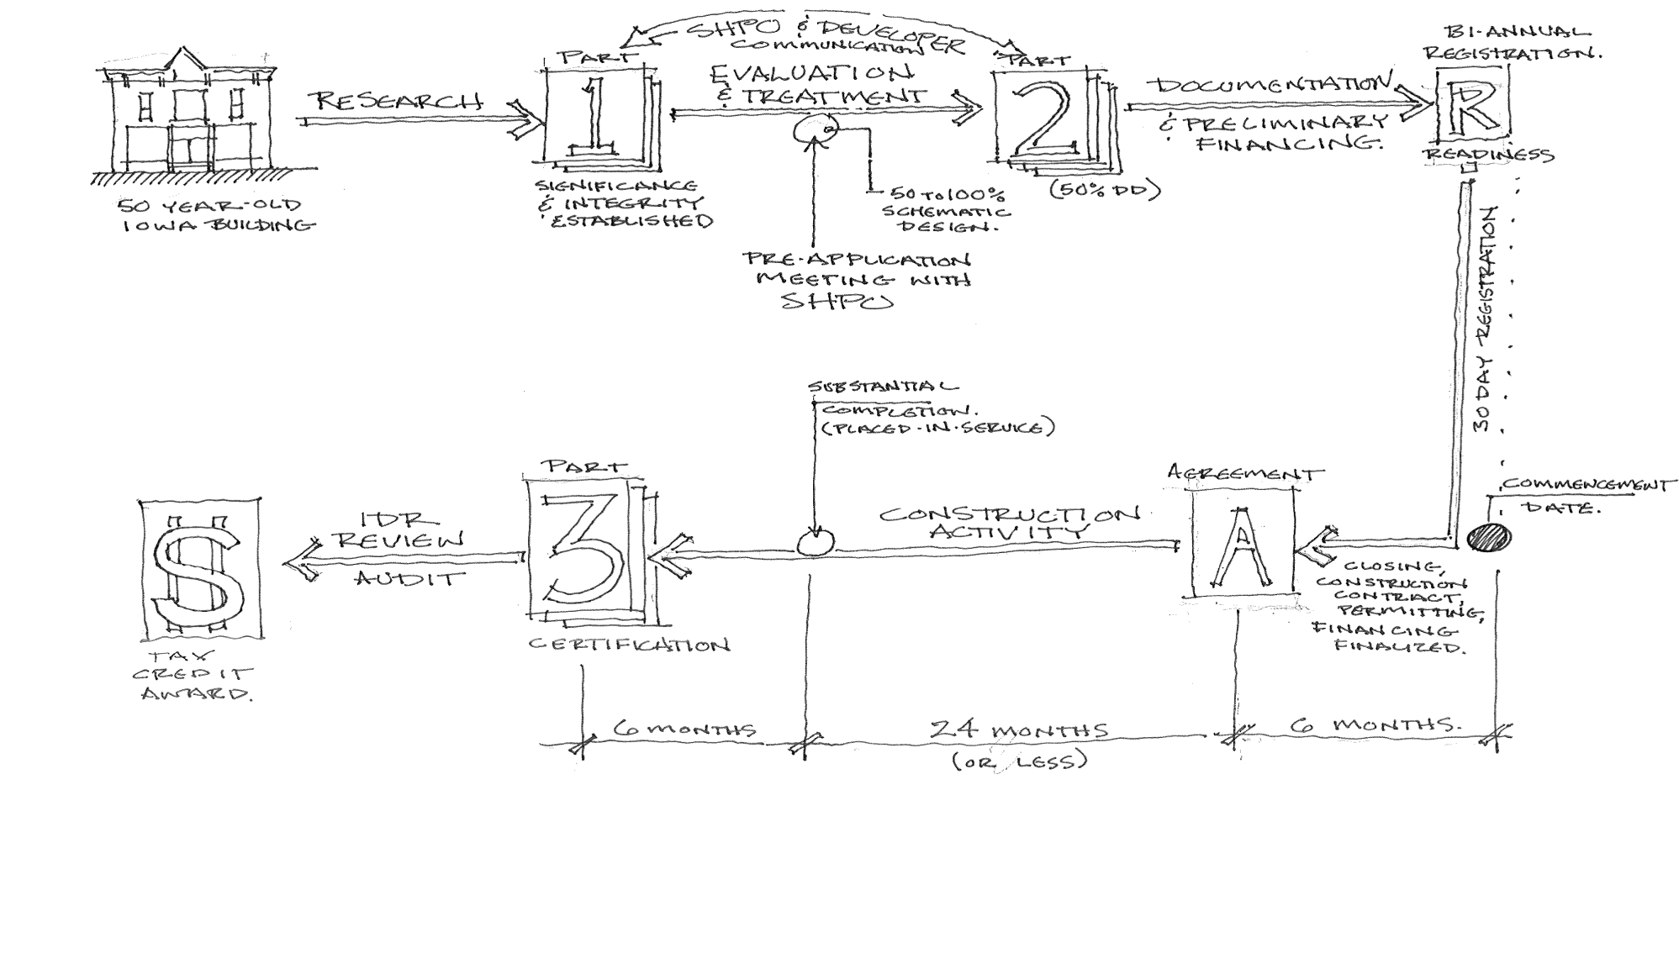
Historic Preservation Tax Credits

