Slide 1
Notes:
Explain a bit about the state tourism office and the many free and easy ways to get involved and promote tourism in western Iowa.

Slide 2
Amy Zeigler Digital Marketing Manager Iowa Tourism Office 515.725.3086 amy.zeigler@iowa.gov
Notes:
I am the digital marketing manager for the tourism office and over the last 4 years we’ve started focusing our marketing efforts on digital marketing and our website. We’ve made enhancements to our site to make it easy for you to submit and update information and photos for attractions in your community. Our website had a 1.5 million visitors in 2015 and we are on that pace again in 2016. Our $2.5 million marketing budget pushes traffic to our website and the printed Iowa Travel Guide is almost entirely sourced from our web database. It’s really the center of our marketing efforts.
Today, I’m going to give you a tutorial in how to get your information on our website, but first, I’m going to explain a bit more about the Iowa Tourism Office.

Slide 3
Digital Marketing - What is it?
Online presence
What do people see if they Google you?
Advertising
Website
Blog
Social Media
SEO
Pay-per-click
Email marketing
Apps
The list goes on!

Slide 4
TravelIowa.com
Notes:
Your solution to getting started – traveliowa.com
1.5 million user sessions each year (and growing). Comprehensive database of

Slide 5
TravelIowa.com
1.5 million user sessions per year (and growing)
Comprehensive database of all tourism-related entities
All Iowa Travel Guide data uses this database
Six active social media channels with audience of 120,000 (and growing)
Consumer email to 40,000 travelers (and growing)
Content marketing staff

Slide 6
TravelIowa.com
It’s free!

Slide 7
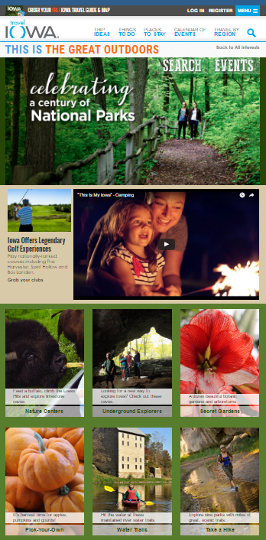

Slide 9
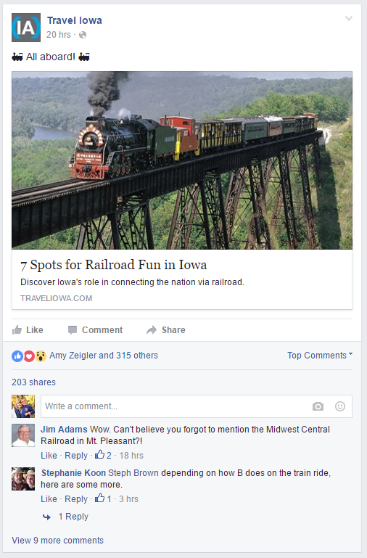
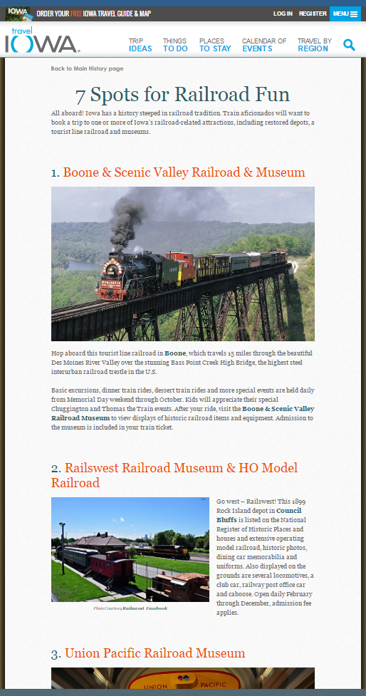

Slide 10
Notes:
Iowa Travel Guide – print 110,000 guides, distributed from online ordering and through our network of welcome centers.
Welcome Centers: Have your materials in the centers. Share what’s new with us so we can share that with travel counselors

Slide 11
How Do I Get Involved?
Submit Your Listings
Submit Your Events
Update Your Community Page
Notes:
So you want to be featured and talked about! Here’s how.
Let’s first take a look at what a listing is – Sawmill Museum and Iowa Children’s Museum.
Scroll to the bottom of the page for the two submission buttons.
Submit A Listing:
Click on orange button
Register/Login
Add a new listing
Update a Listing:
We require all listings to be updated at least once every 18 months – email process
Our web listings are not just used on the web – if your listing meets the guidelines, it is also included in the printed Iowa Travel Guide.
Submitting a listing is also the best way to let us know about new things in your community. Often use photos on our social media channels and to create additional content.
Add Events
Out of the 1.5 million visitors on our website every year, about 20-25% of that traffic searches our calendar.
At any one time, we list anywhere from 1,000 to 1,500 events across the state.
City Pages
Carrie has done a great job of customizing the Clinton page, but if there are any people from other communities, you can customize yours as well.
Ways to Find Listings
Clinton city page
Search
Also in the Area sections of each listing

Slide 12
www.traveliowa.com/conference
Notes:
Registration is now open. Hope to see you there!

Slide 13
Amy Zeigler Digital Marketing Manager Iowa Tourism Office 515.725.3086 amy.zeigler@iowa.gov.

