Slide 1
East & West Nishnabotna River Watershed Management and Flood Resiliency Plans
Summary Presentation

Slide 2
Presentation Outline
Overview of Planning Deliverables
Three parts to each plan:
ASSESSMENT
ACTION
IMPLEMENTATION
Contact Information

Slide 3
Overview of Planning Deliverables

Slide 4
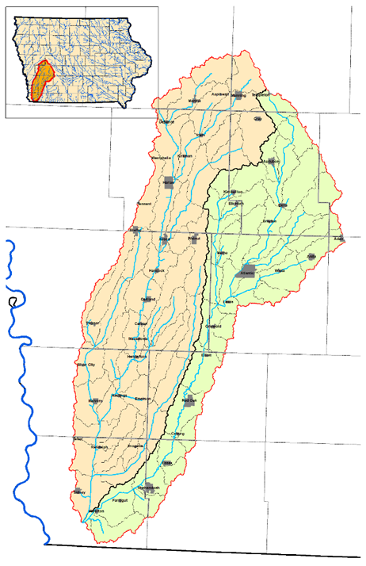
Project Deliverables
Two HUC 8 Watershed Plans
East Nishnabotna
West Nishnabotna
HUC 12 plans (16 of them)
Eight Case Studies
Executive Summary Poster
All PDFs and GIS data provided electronically
HUC 8 West
HUC 8 East

Slide 5
Planning Requirements
The planning components must address the following requirements
NRCS
FEMA
EPA Nine Elements
Plans were reviewed by
Iowa Department of Natural Resources (IDNR)
Iowa Homeland Security and Emergency Management (IHSEM)
Iowa Flood Center (IFC)

Slide 6
HUC 12 Plans
Sixteen HUC 12 watersheds were selected for detailed planning
Agricultural Conservation Planning Framework (ACPF) Tool was utilized identify possible BMP locations
ACPF map books are included with each HUC12 plan

Slide 7
Case Studies
Eight case studies were selected
Each case study evaluated known problems for solutions that could be applied across the watersheds
Case studies completed:
Nishnabotna River Confluence
Counted as 3 case studies
PL-566 Case Study
City of Elliot
City of Randolph
Oxbow Restoration

Slide 8
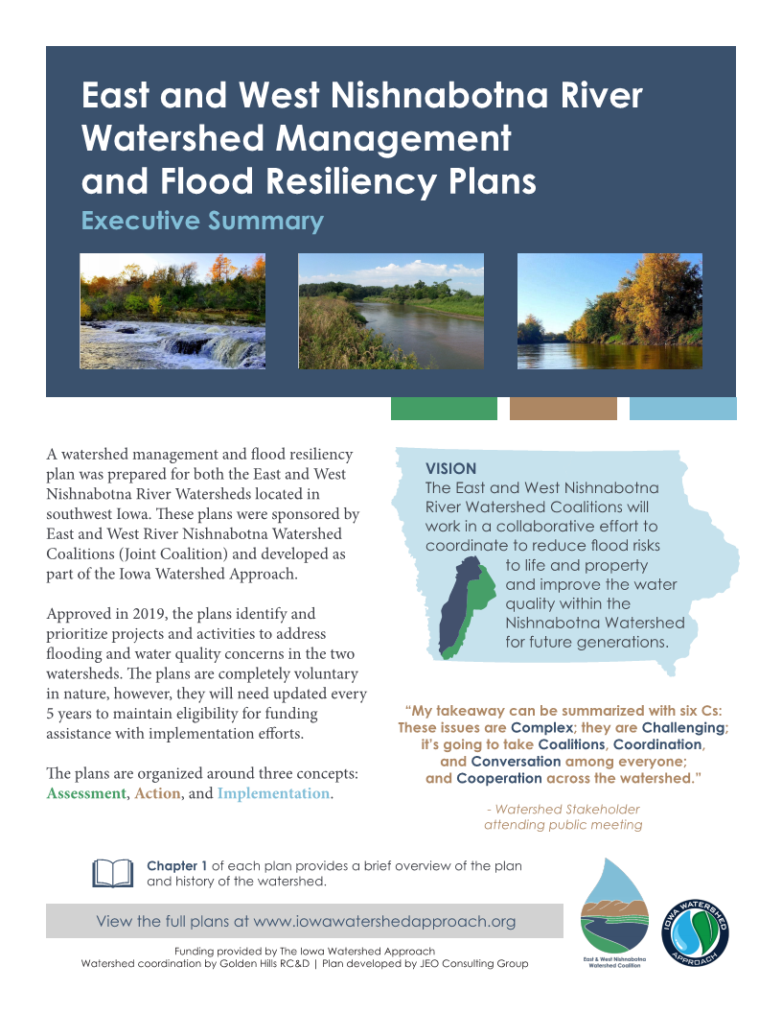
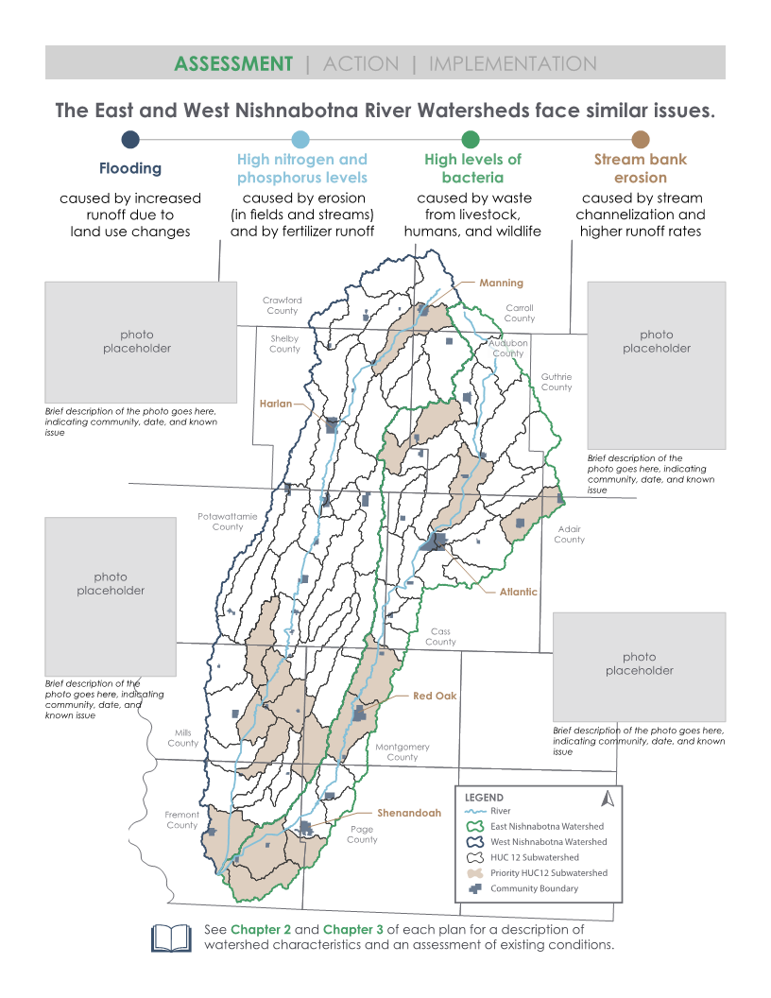
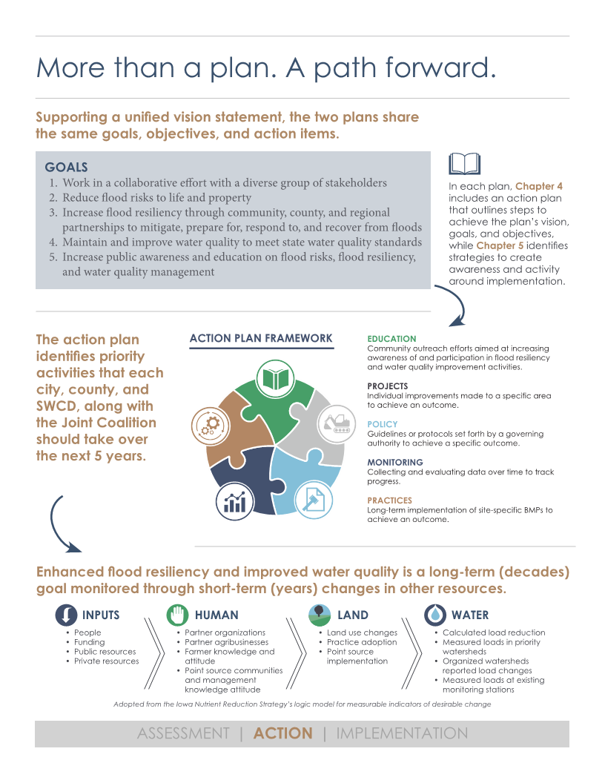
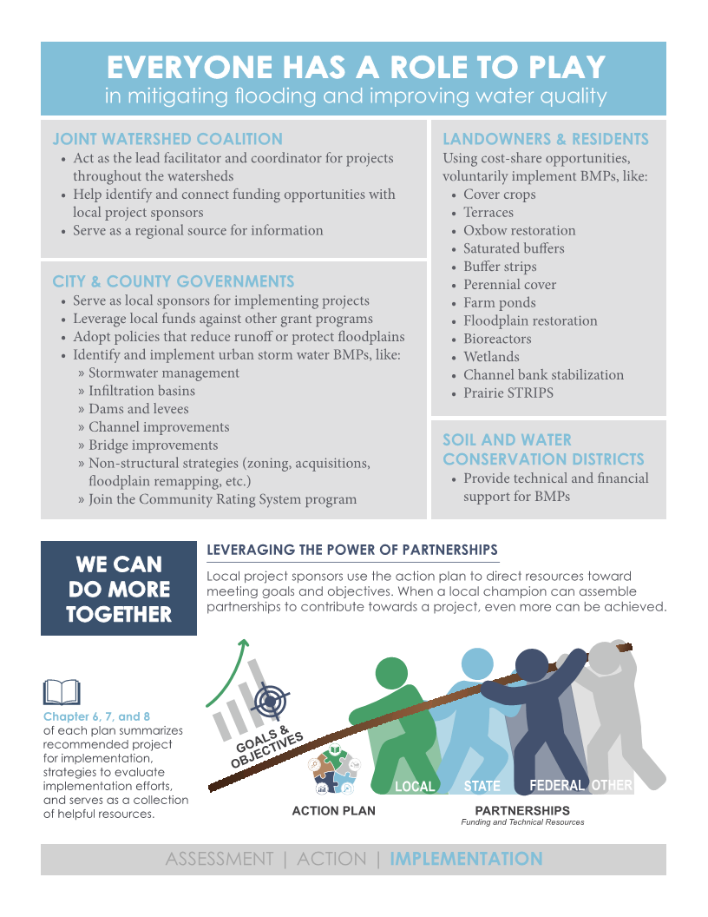
Executive Summary
Provided in 2 formats
Poster - which can be hung in board rooms, offices, etc.
4 page summary – as part of plan document
Link to website to download plan:
http://www.goldenhillsrcd.org/

Slide 9
ASSESSMENT
Chapter 1 – Plan Introduction
Chapter 2 – Watershed Characteristics
Chapter 3 – Current Conditions

Slide 10
Chapter 1 – Plan Introduction
Chapter 1 provides an overview of the following:
Plan purpose and organization
Previously completed projects, plans, and reports
Issues facing the watershed
Historical flooding
Water Quality (nutrients, erosion, and E. coli bacteria)
Planning requirements
Community-based planning process

Slide 11
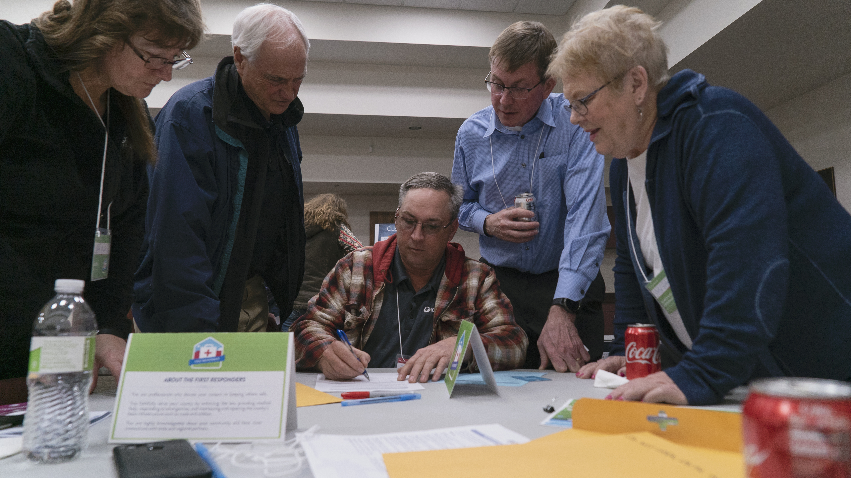
Community-Based Planning
The planning process included the review and input from stakeholders and the general public
Stakeholder included
landowners,
Business owners
Scientific professionals
Citizens
Nonprofit groups
Multiple meetings were held
Four stakeholder meetings
Two flood resiliency tournaments
Three open houses
Participants at one of the flood resiliency tournaments.

Slide 12
Chapter 2 – Watershed Characteristics
Chapter 2 provides an overview of the following:
Watershed boundaries
Demographics
Physical Environment
Climate
Landforms & geology
Topography
Soils
Landuse
Water Resources
Hydrology
Source Water Protection Areas
Wildlife and Habitat
Existing Policy and Regulations
Each watershed is located in the Southern Iowa Drift Plain landform, which has a thick layer of highly erodible loess soil.

Slide 13
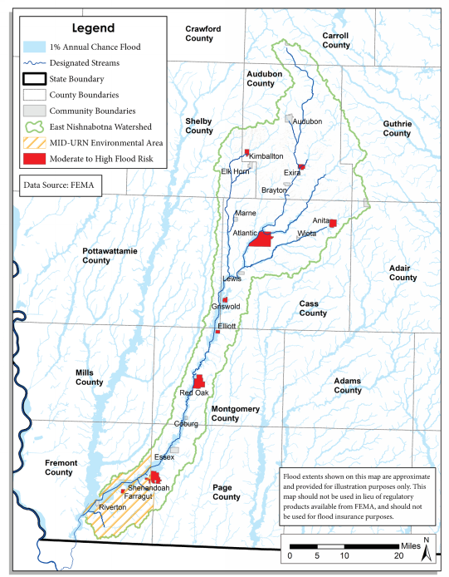
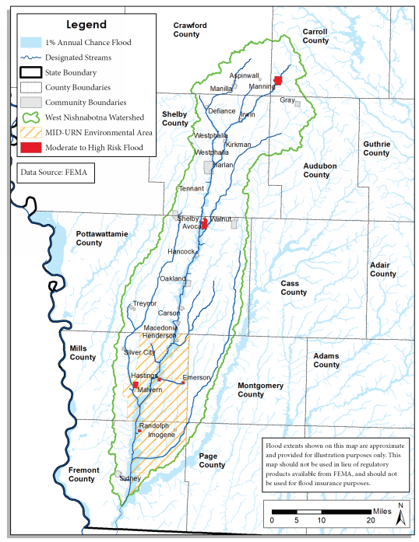
Chapter 3 – Current Conditions
Chapter 3 provides an overview of the following:
Flood Hazard Assessment
Runoff Assessment
Water Quality Assessment
Existing Water Quality
Pollutant Sources and Loads
Existing Best Management Practices
Communities with moderate to high flooding risks were identified.

Slide 14
ACTION
Chapter 4 – Vision, Goals, and Action Plan
Chapter 5 – Public Engagement

Slide 15
Chapter 4 - Vision
Joint Vision Statement
The East and West Nishnabotna River Watershed Coalitions will work in a collaborative effort to coordinate to reduce food risks to life and property and improve the water quality within the Nishnabotna Watershed for future generations.

Slide 16
Chapter 4 - Goals
Work in a collaborative effort with a diverse group of stakeholders
Reduce flood risks to life and property
Increase flood resiliency through community, county, and regional partnerships to mitigate, prepare for, respond to, and recover from floods
Maintain and improve water quality to meet state water quality standards
Increase public awareness and education on flood risks, flood resiliency, and water quality management

Slide 17
Chapter 4 - Action Plan
Developed around a framework
Recommended “top actions” for first 5 years of the plan
Activity
Goals addressed
Timeline
Primary lead agency
Potential partners
Primary technical or funding resources

Slide 18
Chapter 5 – Public Engagement
The plan relies voluntary efforts, which requires educating a wide array of audiences and building partnerships between stakeholders
This chapter outlines:
Target audiences
Strategies
Methods
Evaluation techniques
Existing programs to enhance
The East and West Nishnabotna Watershed Coalition will continue to hold quarterly meetings and engage stakeholders.

Slide 19
IMPLEMENTATION
Chapter 6 – Implementation Summary
Chapter 7 – Plan Evaluation
Chapter 8 – Outside Resources

Slide 20
Implementation Overview
Chapters 6, 7, and 8 comprehensively make up a long term and cohesive approach for implementation of projects
Strategies
BMPs and Projects Evaluated
Benefits
Water quality
Flood resiliency
Costs
The Value of Working Together

Slide 21
Implementation Strategies
Utilize a voluntary approach, rooted in outreach and education;
Encourage the development and adoption of policies that reduce runoff and protect the floodplain within communities;
Promote soil health, which decreases runoff and loss of soil and nutrients;
Promote the adoption of BMPs which store runoff and trap pollutants;
Modify and rehabilitate existing structures to provide or improve benefits for flood reduction or water quality improvements; and,
Promote improved efficiency in the use of manure and commercial fertilizers.
2 concepts capture the essence of these strategies

Slide 22
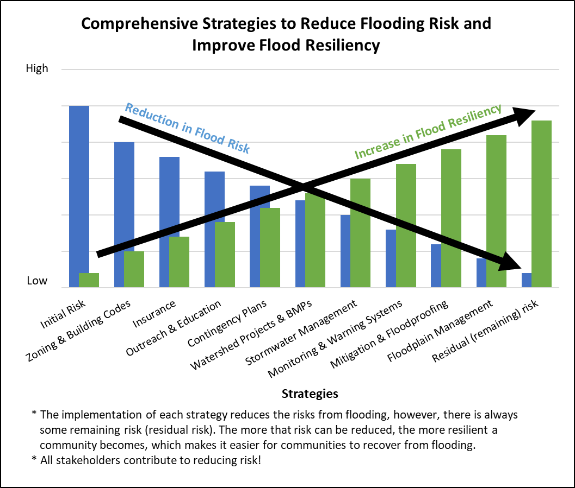
Implementation Strategy Concept 1 – Flood Resiliency

Slide 23
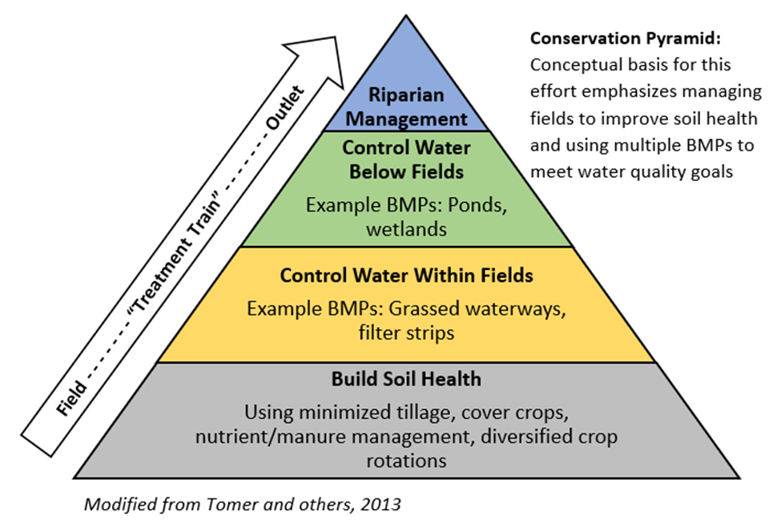
Implementation Strategy Concept 2 – Conservation Pyramid

Slide 24
BMPs Evaluated
Flood Risk Assessment | Water Quality Model
Dams | Information and Education | Wetlands
Channel Widening | Onsite Wastewater Treatment System (OWTS) Upgrade | Farm ponds*
Bridge Improvements | Pet Waste Pick-up | Bioreactors
Levees | Non-structural & Avoidance BMPs | Stream stabilization/ restoration
Infiltration Basins | Small open feedlot BMPs | Terraces
Urban stormwater system upgrades | Drainage water management | Water and sediment control basins (WASCOBs)
Dam rehabilitation / modification | Grazing lands management | Grassed waterways
Non-structural (acquisition, elevation, etc.) | Cover crops* | Land Use Change & Perennial Vegetation*
Floodplain remapping | Riparian buffers | Urban stormwater management
Levee accreditation | Reduced tillage (no-till) | n/a
Join CRS program | Contour buffer strips | n/a

Slide 25
Implementation Projects Identified
Community Flood Mitigation
JEO Matrix Evaluation
Watershed Wide Flood Mitigation
IFC Hydrologic Assessment
Priority Subwatershed Implementation
HUC 12 plans
Case Studies
Special Priorities (primarily for water quality)
Source water protection
On-site wastewater treatment systems
Low head dams
Small open feedlots

Slide 26
Implementation Results Water Quality Benefits (East)
Goal – reduce E. coli to meet water quality standards (126)
Evaluation - JEO team performed water quality modeling within priority HUC 12s – all BMPs looked at
Results - improvements, but more work will be needed
Waterbody Segment ID | Waterbody Segment Name | Estimated Pre-BMP Implementation |  | Estimated Post-BMP Implementation
 |  | Existing Average Annual Load (billion CFU) | Existing Average Seasonal Geometric Mean (CFU/100mL) | Average Annual Load (billion CFU) | Percent Reduction | Average Seasonal Geometric Mean (CFU/100mL)
IA 05-NSH-1415 | Upper East Nishnabotna River | 11,222,000 | 530 | 9,310,000 | 17% | 440
IA 05-NSH-1414 | Lower East Nishnabotna River | 12,280,000 | 272 | 9,742,000 | 21% | 216

Slide 27
Implementation Results Water Quality Benefits (West)
Goal – reduce E. coli to meet water quality standards (126)
Evaluation - JEO team performed water quality modeling within priority HUC 12s – all BMPs looked at
Results - improvements, but more work will be needed
Waterbody Segment ID | Waterbody Segment Name | Estimated Pre-BMP Implementation |  | Estimated Post-BMP Implementation
 |  | Existing Average Annual Load (billion CFU) | Existing Average Seasonal Geometric Mean (CFU/100mL) | Average Annual Load (billion CFU) | Percent Reduction | Average Seasonal Geometric Mean (CFU/100mL)
IA 05-NSH-1441 | West Nishnabotna River | 9,807,000 | 325 | 8,707,000 | 11% | 289

Slide 28
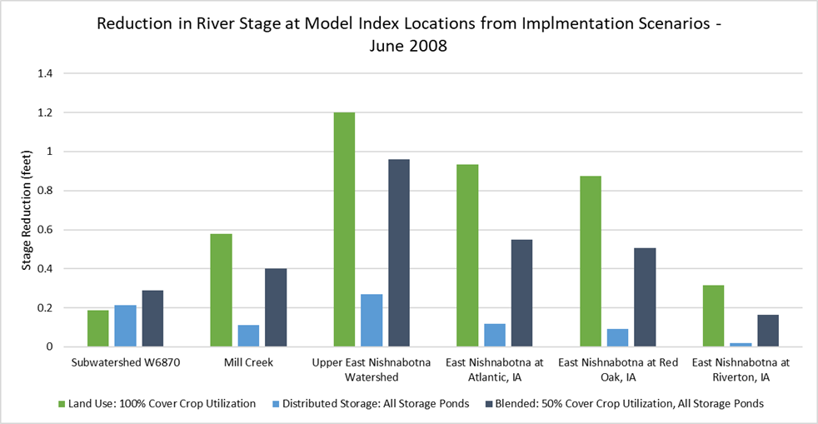
Implementation Results Flood Risk Reduction (East)
Goal – reduce severity and/or frequency of flooding
Evaluation – IFC completed hydrologic assessment for each HUC 8
Cover crops and ponds were used in model
Results - reductions in river stage ranging from 0.16 – 0.96 feet (1.92 – 11.52 inches), depending on location within the watershed

Slide 29
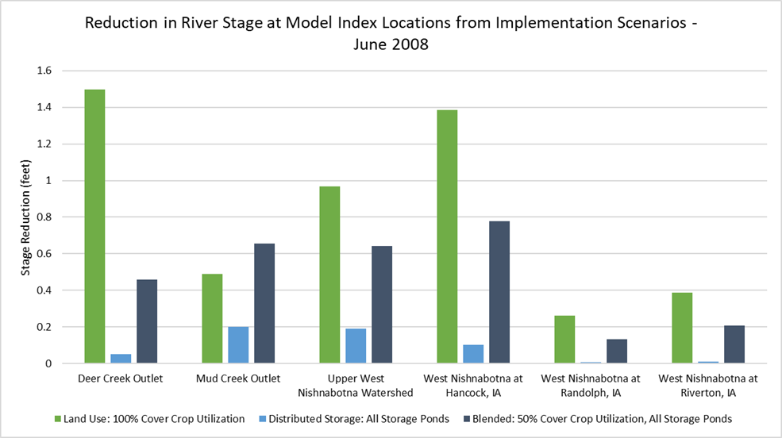
Implementation Results Flood Risk Reduction (West)
Goal – reduce severity and/or frequency of flooding
Evaluation – IFC completed hydrologic assessment for each HUC 8
Cover crops and ponds were used in model
Results - reductions in river stage ranging from 0.13 – 0.78 feet (1.56 – 9.36 inches), depending on location within the watershed

Slide 30
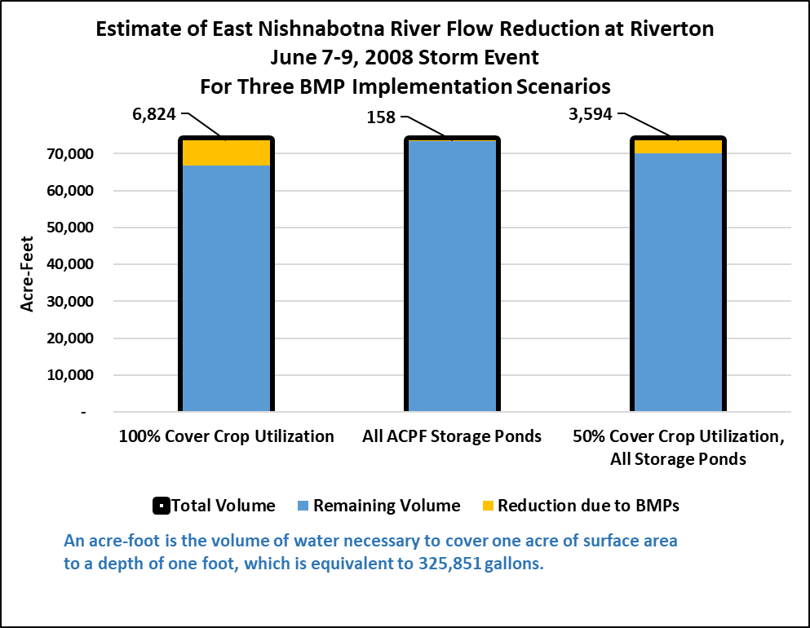
Implementation Results Flood Risk Reduction (East)
River flows during the June 2008 event were converted into gallons acre-feet
An acre-foot is the volume of water necessary to cover one acre of surface area to a depth of one foot
Equivalent to 326,000 gallons
Modeling showed a reduction of 3,600 acre-feet
1.1 billion gallons
Enough water to cover a city the size of Carroll, IA with one foot of water.

Slide 31
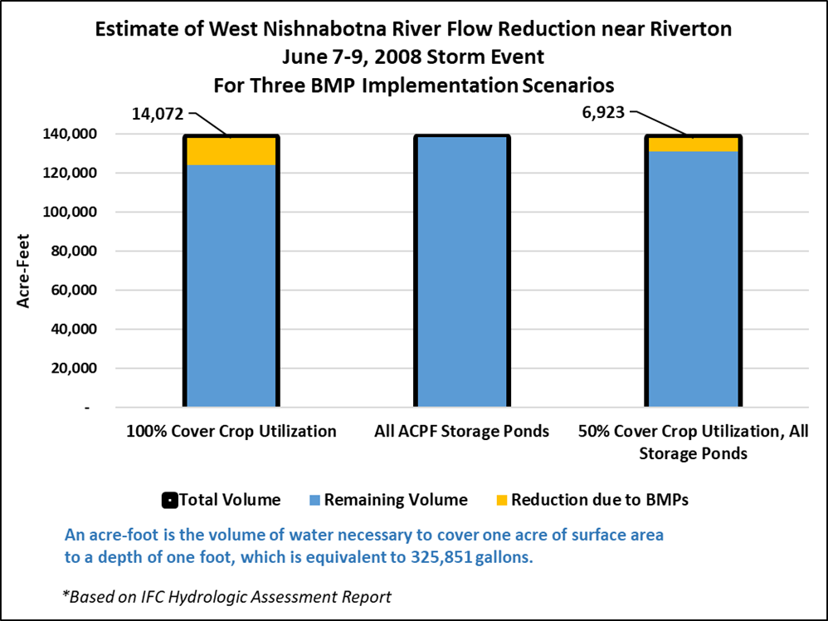
Implementation Results Flood Risk Reduction (West)
River flows during the June 2008 event were converted into gallons acre-feet
An acre-foot is the volume of water necessary to cover one acre of surface area to a depth of one foot
Equivalent to 326,000 gallons
Modeling showed a reduction of 6,900 acre-feet
2.2 billion gallons
Enough water to cover a city the size of Carroll, IA with one foot of water.

Slide 32
Estimated Costs
Community Flood Mitigation
$1.2 – 3.2 million per community
9 communities (east)
6 communities (west)
HUC 12 BMP Implementation
$2.3 – 11.5 million per HUC 12
16 HUC 12s
Case Studies
Highly variable
Some are in both East and West watersheds
Total (East Nishnabotna) = $89 Million
Total (West Nishnabotna) = $64 Million

Slide 33
How to Pay for Everything?
Not all of this work should be considered “one project”
The work can be phased in over time
Many of these projects
Cross jurisdictional boundaries
Have downstream and/or upstream benefits
Require partnerships to qualify for funding
Costs for most projects could be covered from a mix of sources (voluntary)
Cities
Counties
SWCDs
NRCS
Landowners
State agencies
IDALS
IDNR
Grants
Non-profits
Other sources TBD

Slide 34
To Achieve Flood Resiliency Everyone Has a Role to Play
Watershed Coalition
Facilitate and coordinate efforts across political boundaries
Identify and connect funding
Regional source of information
City & County
Local sponsors for some projects
Leverage local funding
Adopt policies to reduce runoff
Urban BMPs
Soil & Water Conservation Districts
Assist with Ag BMPs
Financial & technical assistance
Landowners & Residents
Utilize cost-share opportunities to implement BMPs

Slide 35
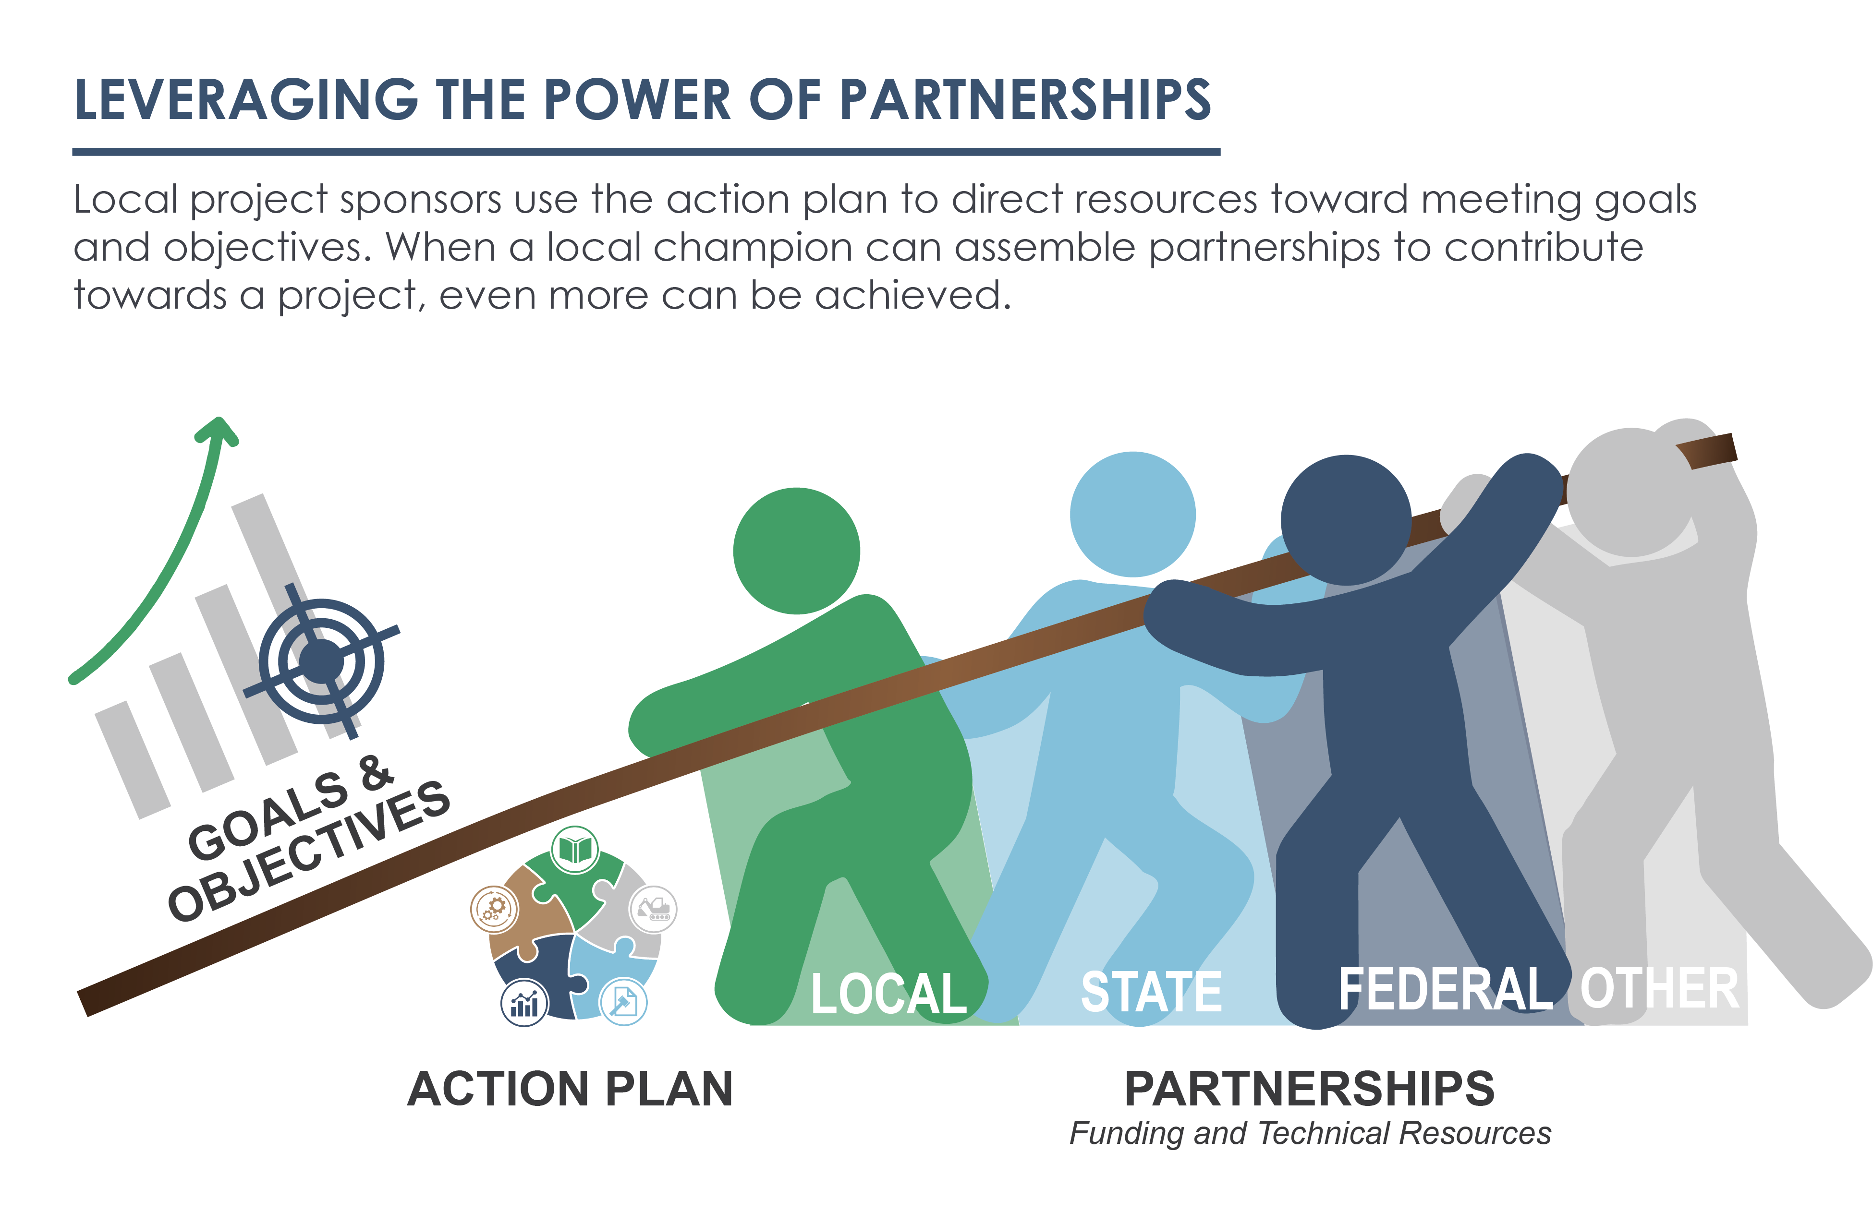
The Bottom Line
It is up to you to take the next steps
As a watershed organization
As cities
As counties
As SWCDs
Are you prepared for when the Iowa Watershed Approach is over?
The recommended next major steps are outlined in the ACTION PLAN

Slide 36
Questions?

Slide 37
THANK YOU!
GOLDEN HILLS RC&D
Watershed Coordinator
Cara Marker-Morgan | 712.482.3029 | cmorgan@goldenhillsrcd.org

